Slide 1
Space Weathering of Carbonaceous Asteroids
Beau Prince¹
Mark Loeffler²
¹Department of Applied Physics and Materials Science, Northern Arizona University
²Department of Astronomy and Planetary Science, Northern Arizona University

Slide 2
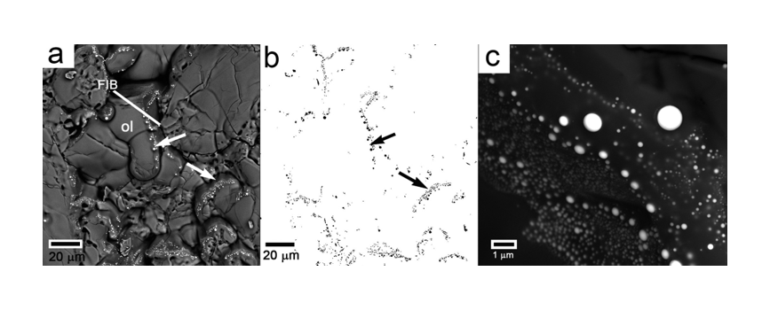
A Bit on Space Weathering
Airless surfaces are subject to bombardment by micrometeorites and solar wind
Chemical and topographical changes alter reflectance spectrum
Loeffler et al. 2016
In S-type asteroids, formation of nanophase iron via space weathering processes causes darker, more positively sloped reflectance spectrum

Slide 3
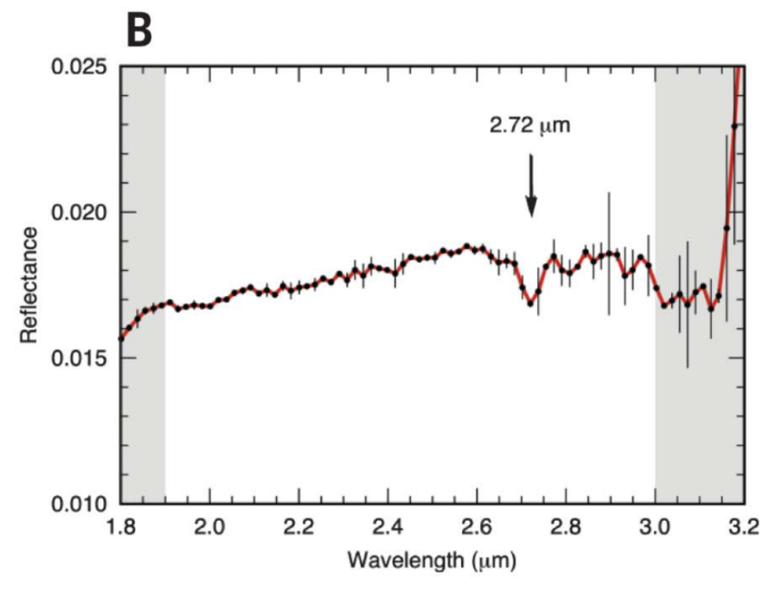
Reflectance of Carbonaceous Asteroids
Hamilton et al. 2019, Clark et al. 2011
Kitazato et al. 2019
Bennu
(Blue)
Ryugu
(Red)

Slide 4
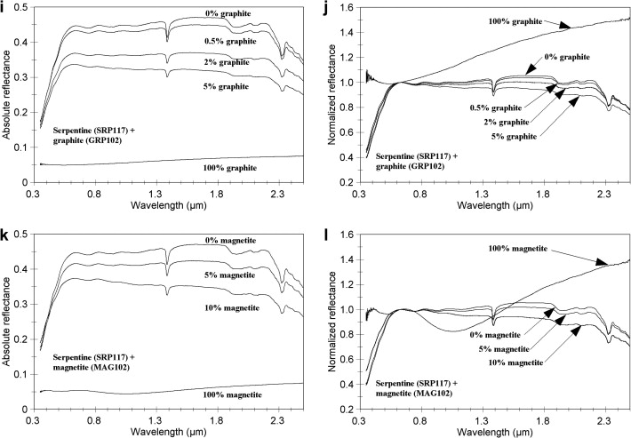
Space Weathering of Carbonaceous Asteroids
What Makes an Asteroid Blue?
First, we investigated the origins of a blue spectrum without space weathering
Silicate + dark material ≈ Asteroid
(sort of)
Cloutis et al. 2011

Slide 5
Mixture Experiments
We made binary (two-component) mixtures of forsterite (Mg₂SiO₄) and graphite, magnetite (Fe₃O₄), and troilite (FeS)
Each individual opaque is red by itself
Loeffler & Prince 2022

Slide 6
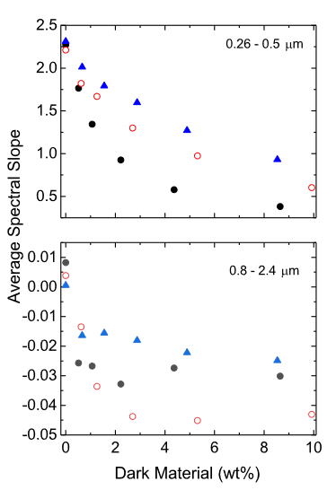
Mixture Experiments
Graphite
Graphite
Magnetite
Troilite
Magnetite
Troilite
Loeffler & Prince 2022
Loeffler & Prince 2022

Slide 7
Rayleigh Scattering
Rayleigh Scattering Efficiency scales as $\frac{1}{λ^{4}}$
Rayleigh approximation holds up to $nX \sim 1.21$, where n is the real index of refraction
$⟹$ Rayleigh approximation holds for only
sufficiently small scatterers
Brown 2014
$$k=\frac{2π}{λ}$$
$$m=(complex index of refraction)$$
$$a=(radius of idealized spherical particle)$$
$$X=ka$$

Slide 8
The Case Against Rayleigh Scattering
Smaller grain size
Larger gain size
Loeffler & Prince 2022

Slide 9
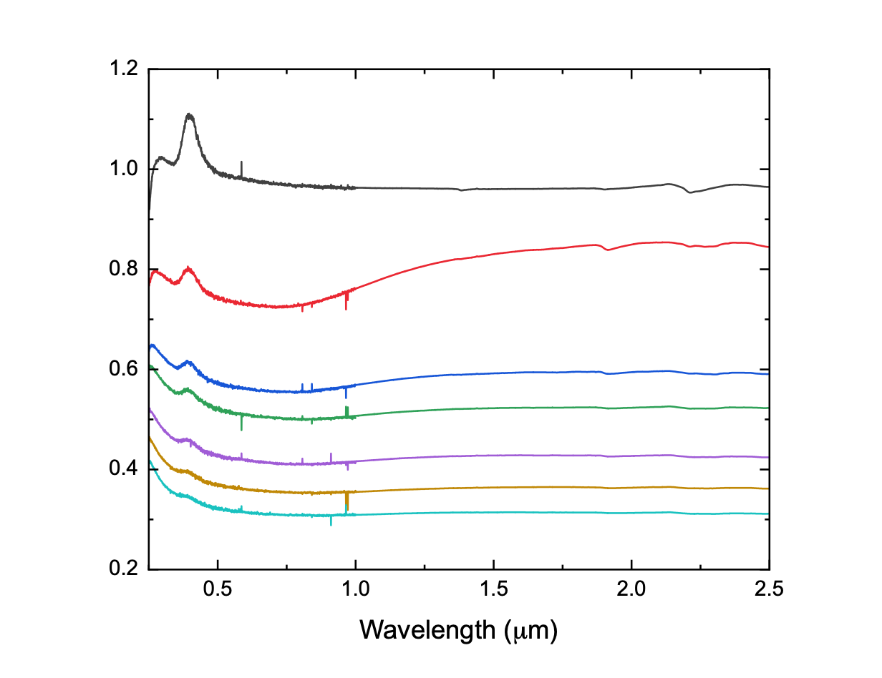
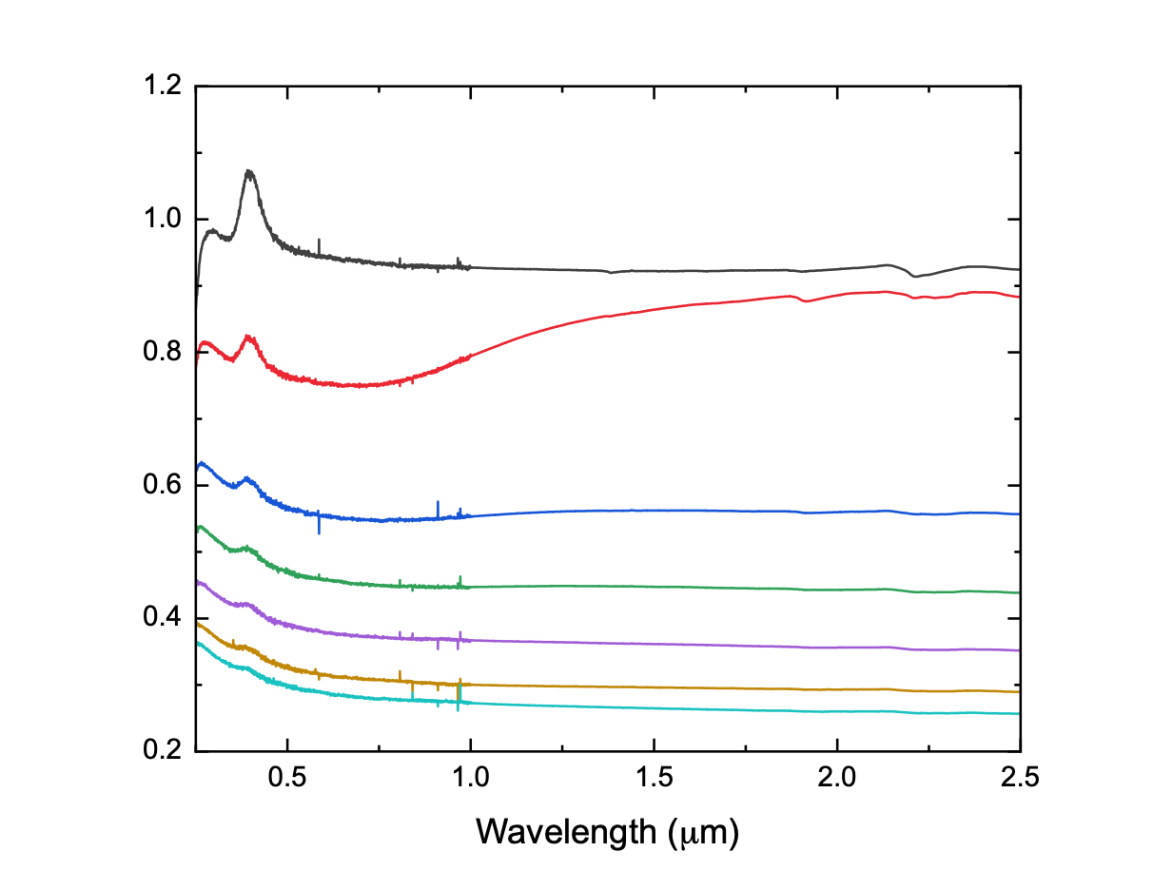
Future Work–Kerogenic Material
SiO₂ + Coal + Graphite
SiO₂ + Coal + Magnetite
Wt%
Wt%
SiO₂
SiO₂
0.5%
0.5%
1.0%
1.5%
1.0%
2.5%
1.5%
3.5%
2.5%
3.5%

Slide 10
Thank you

